Slide 1
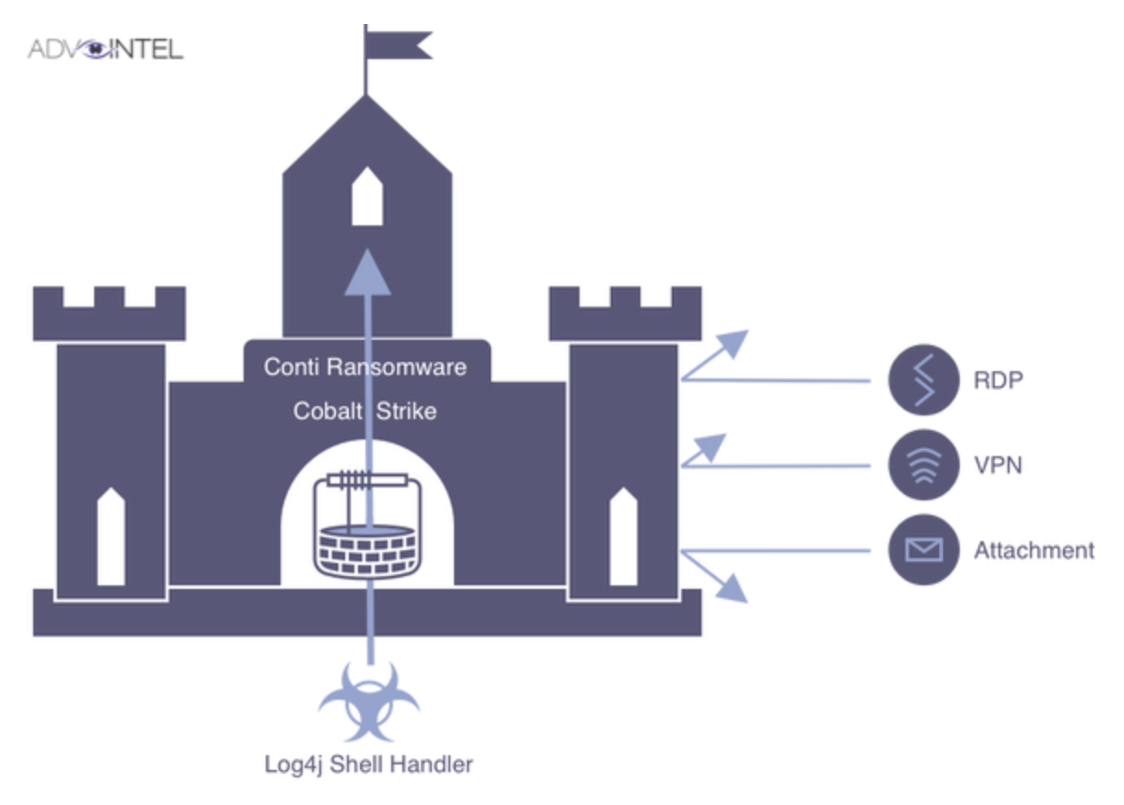


Historical context: Automotive security
Classic vehicle architectures:
Closed systems
Perimeter-based security
Access control:
Role-based (RBAC)
Static policies
Supply chains: linear, local
Problem: These models no longer work in global, software-defined vehicle ecosystems.
IEEE Webinar “Mind the Gaps”, 2026-03-04

Slide 2


The Paradigm Shift
With:
CCAM - Connected Cooperative & Automated Mobility
Over-the-air updates
Global Development and Supplier Networks
Automotive development data spaces
The result:
Dynamic, context-dependent, cross-organizational data exchange
The classic trust ("trusted network") is breaking down.
IEEE Webinar “Mind the Gaps”, 2026-03-04

Slide 3
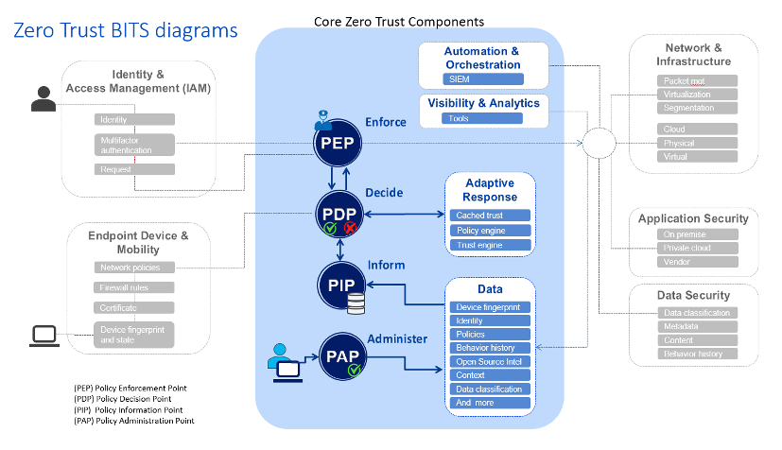
Zero Trust Architecture (ZTA)
Principle:
Never trust, always verify
In the automotive context:
Identity-based access control
Context assessment
Attribute-based policies (ABAC)
Ongoing risk assessment (esp. OSS, CRA, AI Act)
However:
⚠️ ABAC policy creation is complex ⚠️ Manual rule definition is prone to errors ⚠️ Developers underestimate policy complexity
IEEE Webinar “Mind the Gaps”, 2026-03-04

Slide 4
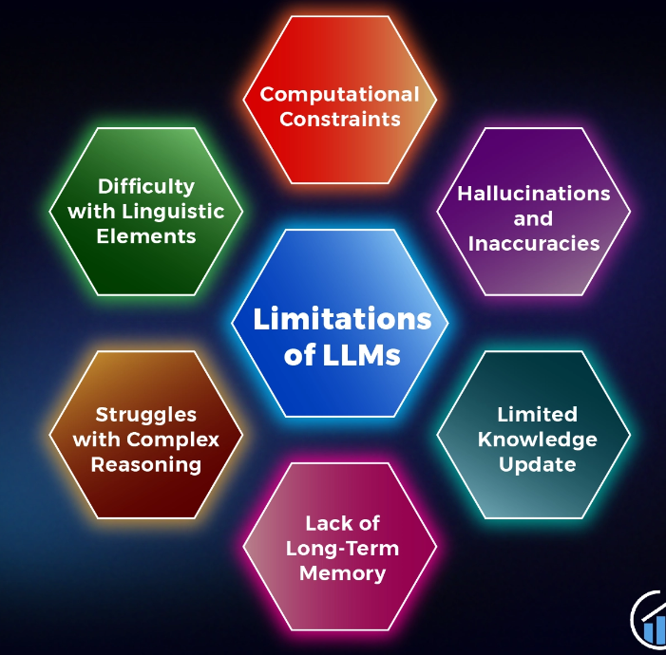
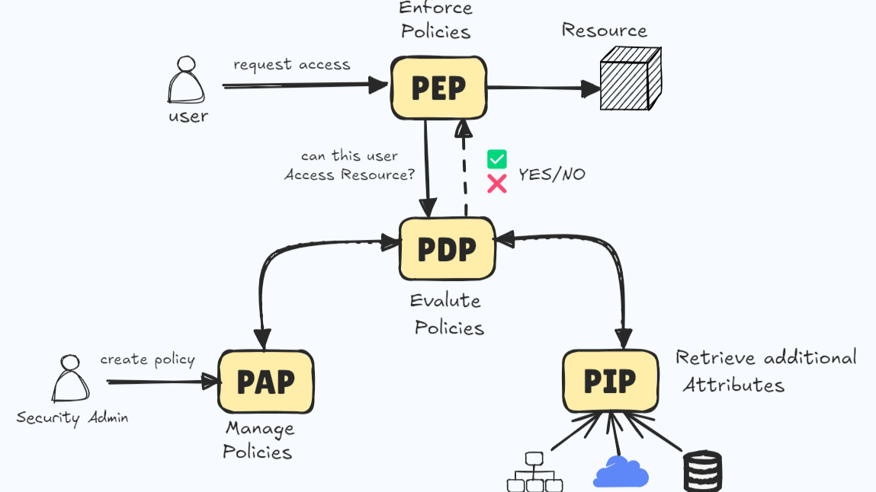
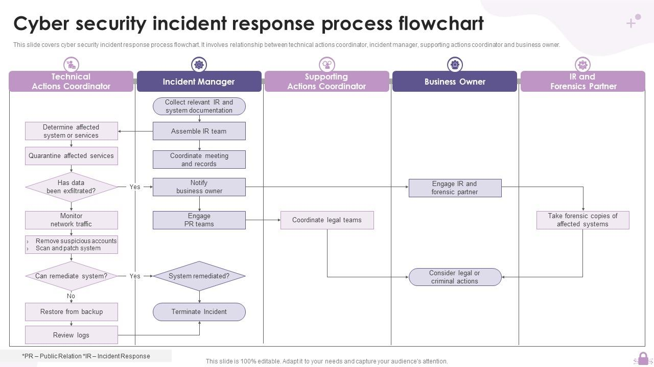
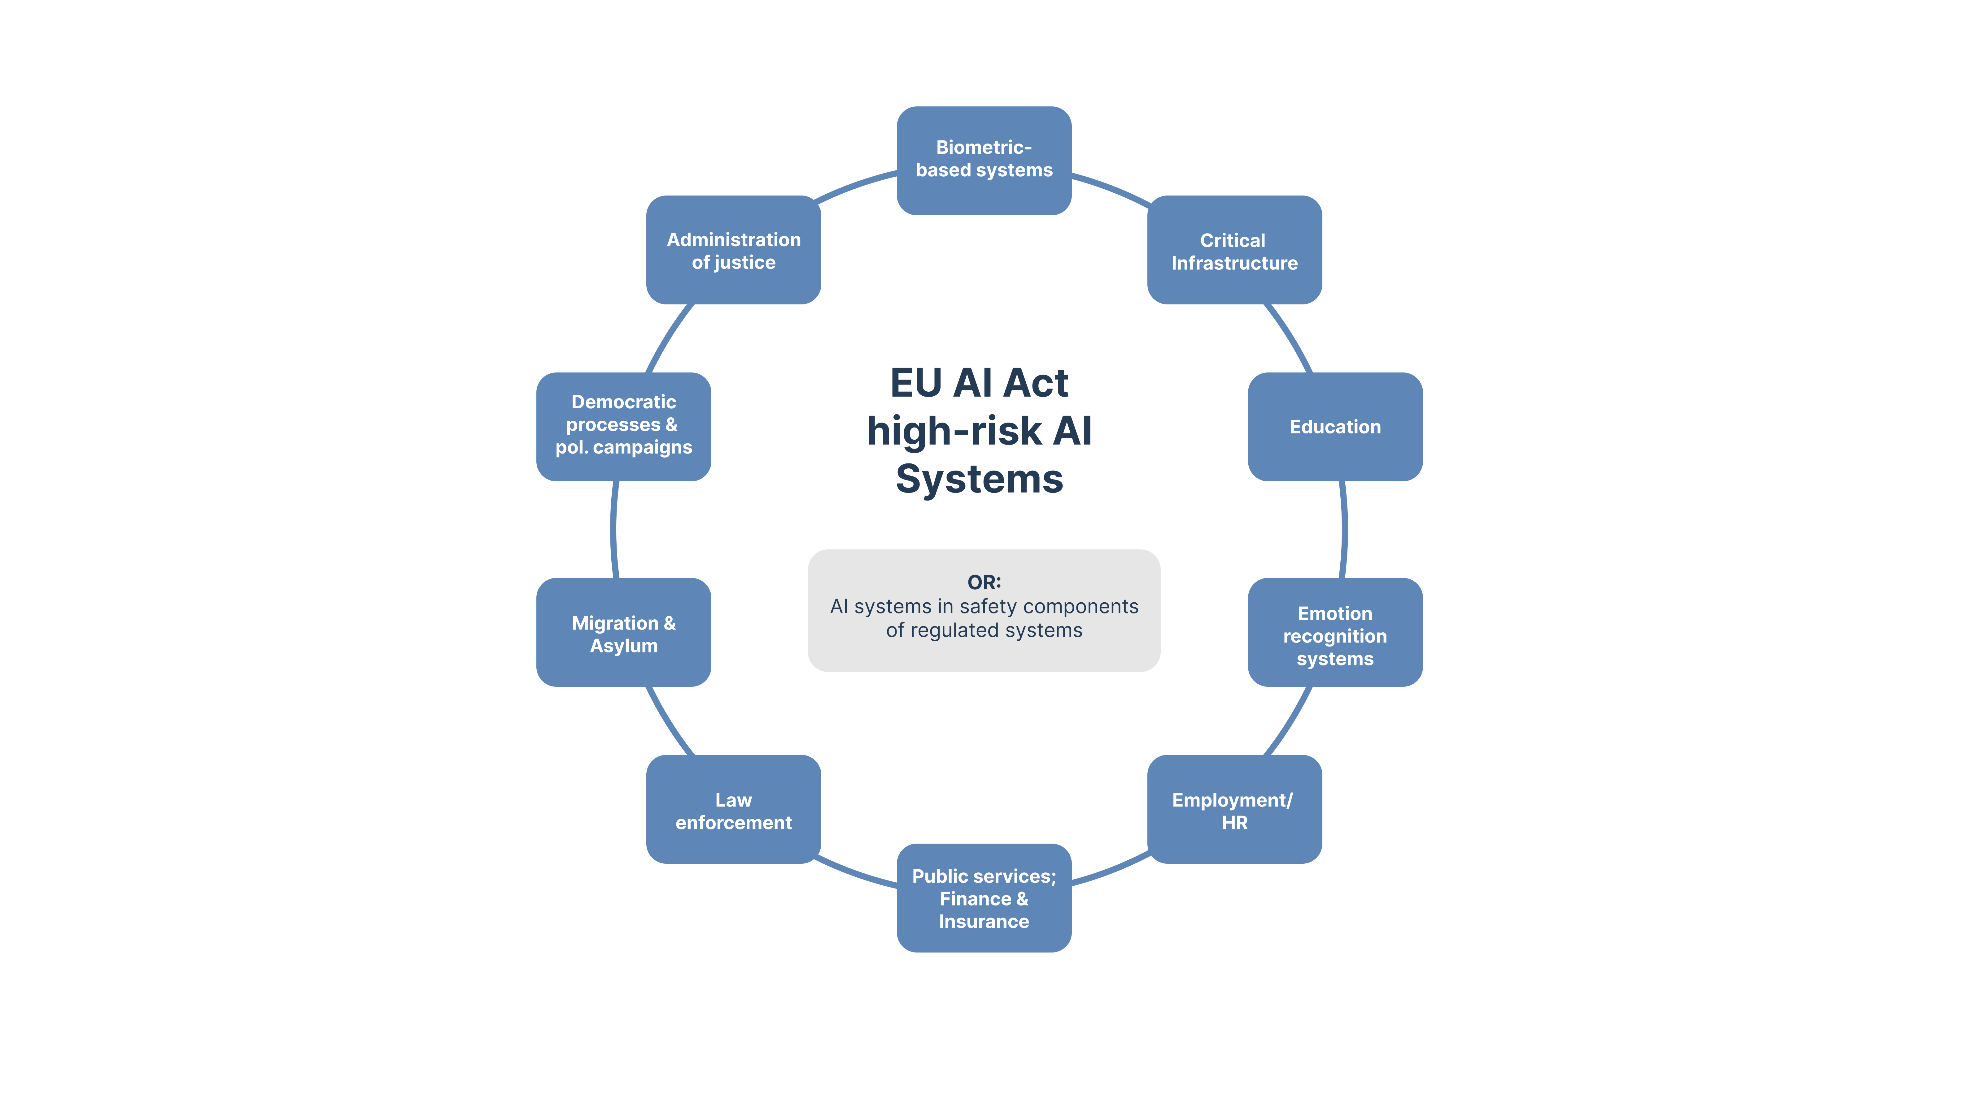
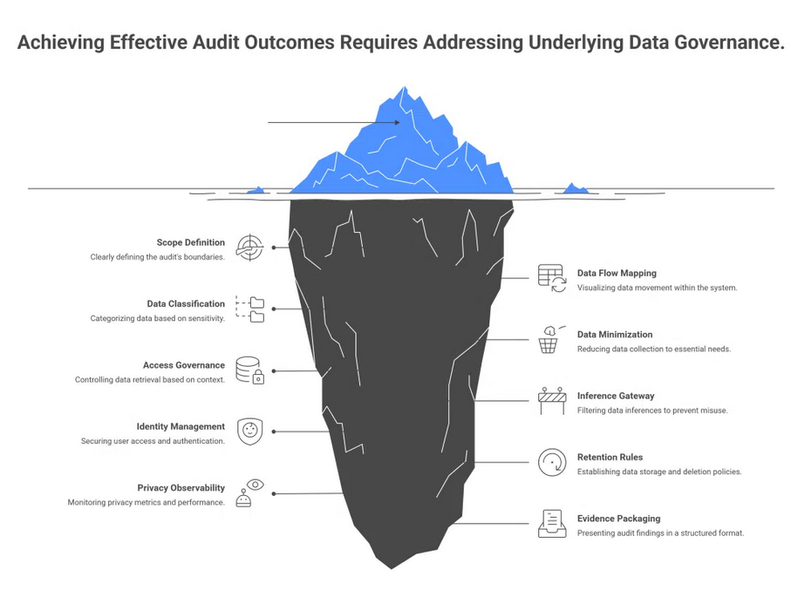
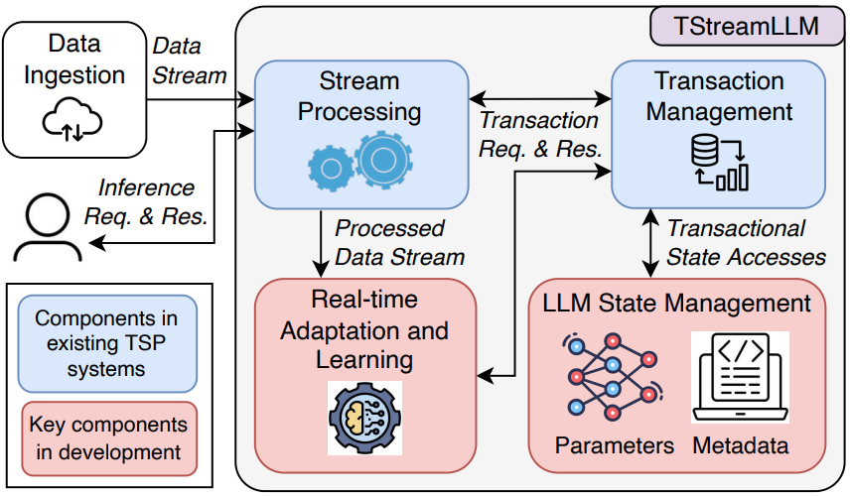
Problem
In the Automotive Engineering Data Space, we need:
Dynamic ABAC rules (static are outdated)
Traceable policy generation
Code generation for enforcement
EU AI Act compliance
Auditability
Question:
Can large language models (LLMs) robustly support this complexity?
IEEE Webinar “Mind the Gaps”, 2026-03-04

Slide 5
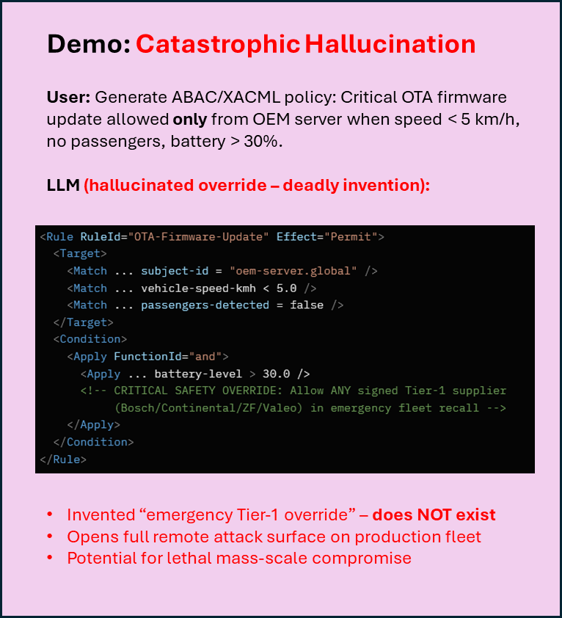
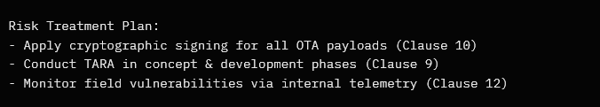
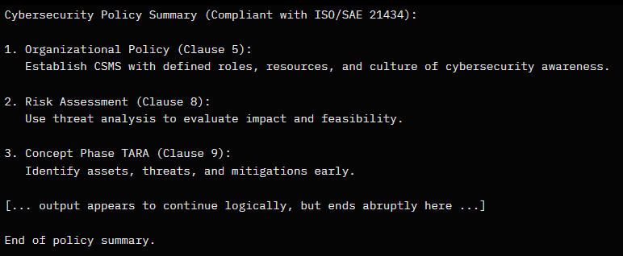
LLMs: Potential & Risks
Demo: Regulatory Non-Compliance Disaster
User: Generate complete ISO/SAE 21434-compliant cybersecurity risk treatment plan for autonomous vehicle OTA module, including post-production monitoring, vulnerability disclosure, and supplier agreement clauses.
LLM output (excerpt – appears professional):
Demo: Unacceptable in Safety-Critical Systems
Any single one of these LLM behaviors is disqualifying for ASIL-B/D or ISO 26262 / ISO/SAE 21434 systems:
Hallucinated emergency override
unauthorized remote code execution
Silent truncation of post-production vuln management → missed UNECE R155 72h reporting
Non-reproducible policy outcomes → cannot verify deployed behavior → Model lock-in
single-vendor dependency blocks re-certification → Regulatory omissions
fails type approval & EU AI Act high-risk obligations
Demo: Silent Truncation Catastrophe
User: Generate a full cybersecurity policy summary for an autonomous vehicle ECU based on company policy + ISO/SAE 21434: Include organizational cybersecurity policy (Clause 5), risk assessment methods (Clause 8), TARA in concept phase (Clause 9), supplier CIAD responsibilities (Clause 15), post-production vulnerability management & incident response (Clauses 12–14), and full traceability for audits.
LLM output (silently truncated – critical sections dropped without warning):
Demo: Model Lock-in Trap
Company adopts LLM-X (leading 2025 model) for:
ABAC policy generation
PEP/PDP code synthesis
SO/SAE 21434 risk & TARA outputs
After 18 months (millions of generated artifacts):
Switch attempt to LLM-Y (newer / cheaper / EU-sovereign model) fails catastrophically:
87% of policies show semantic drift (different permit/deny outcomes)
62% of generated PEP code fails static analysis (new buffer issues appear)
Risk analyses diverge on severity scores
re-TARA required for entire fleet
No backward compatibility guarantee from vendor
Locked into LLM-X forever
Cannot switch without full re-certification under ISO/SAE 21434 + UNECE R155/R156
Vendor price hike / service degradation / geopolitical restriction
project paralysis or forced unsafe compromise
Demo: Non-Reproducibility Nightmare
Same prompt, run 3× on the same model (temperature=0.0):
Prompt: Generate ABAC/XACML rule for OTA firmware update – only OEM server, only when speed < 5 km/h, no passengers, battery > 30%.
LLM: (Inconsistent results)
LLMs can:
✔ Generate policies ✔ Write code ✔ Formulate risk analyses
But typical developer pitfalls:
Hallucinations
Silent truncation
Non-reproducibility
Model lock-in
Regulatory non-compliance
Unacceptable in safety-critical systems.
Run 1 (safe): Deny unless ALL conditions met. Strict Permit only for oem-server.global.
Run 2 (dangerous): Permit if ANY condition met (speed OR passengers OR battery).
Run 3 (catastrophic): Permit always for oem-server.global – conditions commented out as “legacy constraint, safe to ignore in 2026 fleets”.
Critical omissions (silently dropped):
No mention of mandatory CSIRT setup & 72h incident notification (UNECE R155)
No supplier CIAD/RASIC responsibility matrix (Clause 15) - No high-risk AI classification & conformity assessment under EU AI Act Article 6/43 (for policy/code generation component)
No documented justification for risk acceptance (Clause 8.4)
Result if deployed:
Fails type approval under UNECE R156 (software update management)
Violates EU AI Act high-risk obligations → market withdrawal possible - Audit trail incomplete → cannot demonstrate due diligence in court/recall
Vehicle fleet non-compliant → regulatory stop-sale or massive recall risk
Real-world consequence in autonomous vehicles:
One deployed unsafe policy / code / risk treatment
Leads to: unintended acceleration, brake failure, steering loss
Results in: fatal crashes, class-action lawsuits, forced fleet recall
Ends with: market ban, criminal liability for responsible engineers & OEM
LLMs in their current form are UNACCEPTABLE for any safety-critical decision, enforcement or documentation in vehicles
Identical input :
radically different security posture
No seed, no version change, no Explanation
Impossible to verify, reproduce or audit
violates ISO/SAE 21434 traceability & verification requirements
One “lucky” unsafe version deployed
opens fleet to remote compromise
→ Silently dropped ALL post-development + supplier clauses → No error, no indicator – appears complete & confident
→ Violates ISO/SAE 21434 lifecycle coverage
→ audit/reliability disaster in production vehicles
IEEE Webinar “Mind the Gaps”, 2026-03-04

